Slide 1
Adding parameters
Adding PARAMETER and WRITE functionality to newer ABAP
environments

Slide 2
Background
Traditional ABAP reports were written so that they could accept some parameters from an end user who would use the Execute function to generate some output which was presented to the user.
This assumed the users were using SAPGUI.
Newer ABAP runtimes are moving to a browser-based frontend, with no ability to collect parameters from the users, or present the output.
The attached is a possible mechanism to provide the ability to collect parameters from an end user and generate some output.
It relies on an ABAP global class, with public methods used to define the parameters, and then execute some code based on those parameters.

Slide 3
Pull from Git (ABAP on premise)
Create a package ZPARAMS
Use SA38 to execute ZABAPGET_STANDALONE
If prompted, create a change request
Use the option for a new Online repository
URL: https://github.com/michaelnicholls/ZPARAMS.git
Package: ZPARAMS
Pull
There might be some warnings

Slide 4
Pull from Git (BTP ABAP)
Create a package ZPARAMS
Use AbapGit repositories tab to add https://github.com/michaelnicholls/ZPARAMS.git
Use package ZPARAMS and option to Pull after Link
There might be some warnings
Activate the two database tables
Activate ZCL_GETSETPARAMS and ZCL_PARAMS_HTTP
Create new HTTP service ZCL_PARAMS_HTTP implementing ZCL_PARAMS_HTTP

Slide 5
Tables imported
ZPARAMS – user specific parameters
ZOUTPUT – any lines of output for this user

Slide 6
Launch the HTTP service
On premise:
Transaction SICF
Search for service Z*
Right click ZMN_HTTP and select Test service
Enter your ABAP credentials
BTP ABAP:
Open Connectivity -> HTTP Service -> ZCL_PARAMS_HTTP
Click the URL link
Enter your BTP ABAP credentials
Optional URL parameters: class=ZCL_ZZZ and method=METHOD
Check that ZCL_MN_DEMO is active
You can test with Global class: ZCL_MN_DEMO, Method: INIT -> Execute
Enter some values for Integer1, Operator, and Integer2
Set method to MAIN -> execute
You should see the result

Slide 7
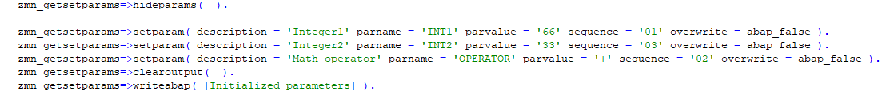
INIT method example
hideparams – hides existing parameters
setparam – sets a parameter name, description, value, sequence in the web frontend, whether to overwrite an existing value
clearoutput – clears any output
writeabap – writes a line to the output

Slide 8
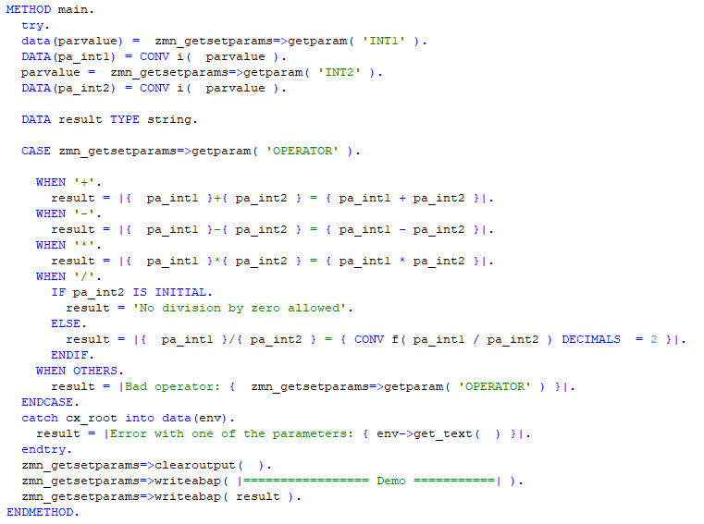
MAIN method example
getparam – gets the value of a parameter

Slide 9
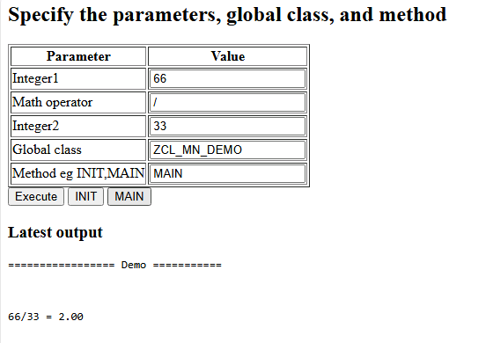
Example output
After INIT, entering some values, and MAIN

